Slide 1

API, JSON, Web-hooks
and SDK
Saksham Arora
GenAI

Slide 2



Saksham Arora
Saksham Arora - Intuit | LinkedIn
Software Engineer 2 @ Intuit
Ex - Software Engineer @ Microsoft
2 Times Intern at Microsoft + 1 intern at Amazon
Founding Engineer at Crio.do

Slide 3


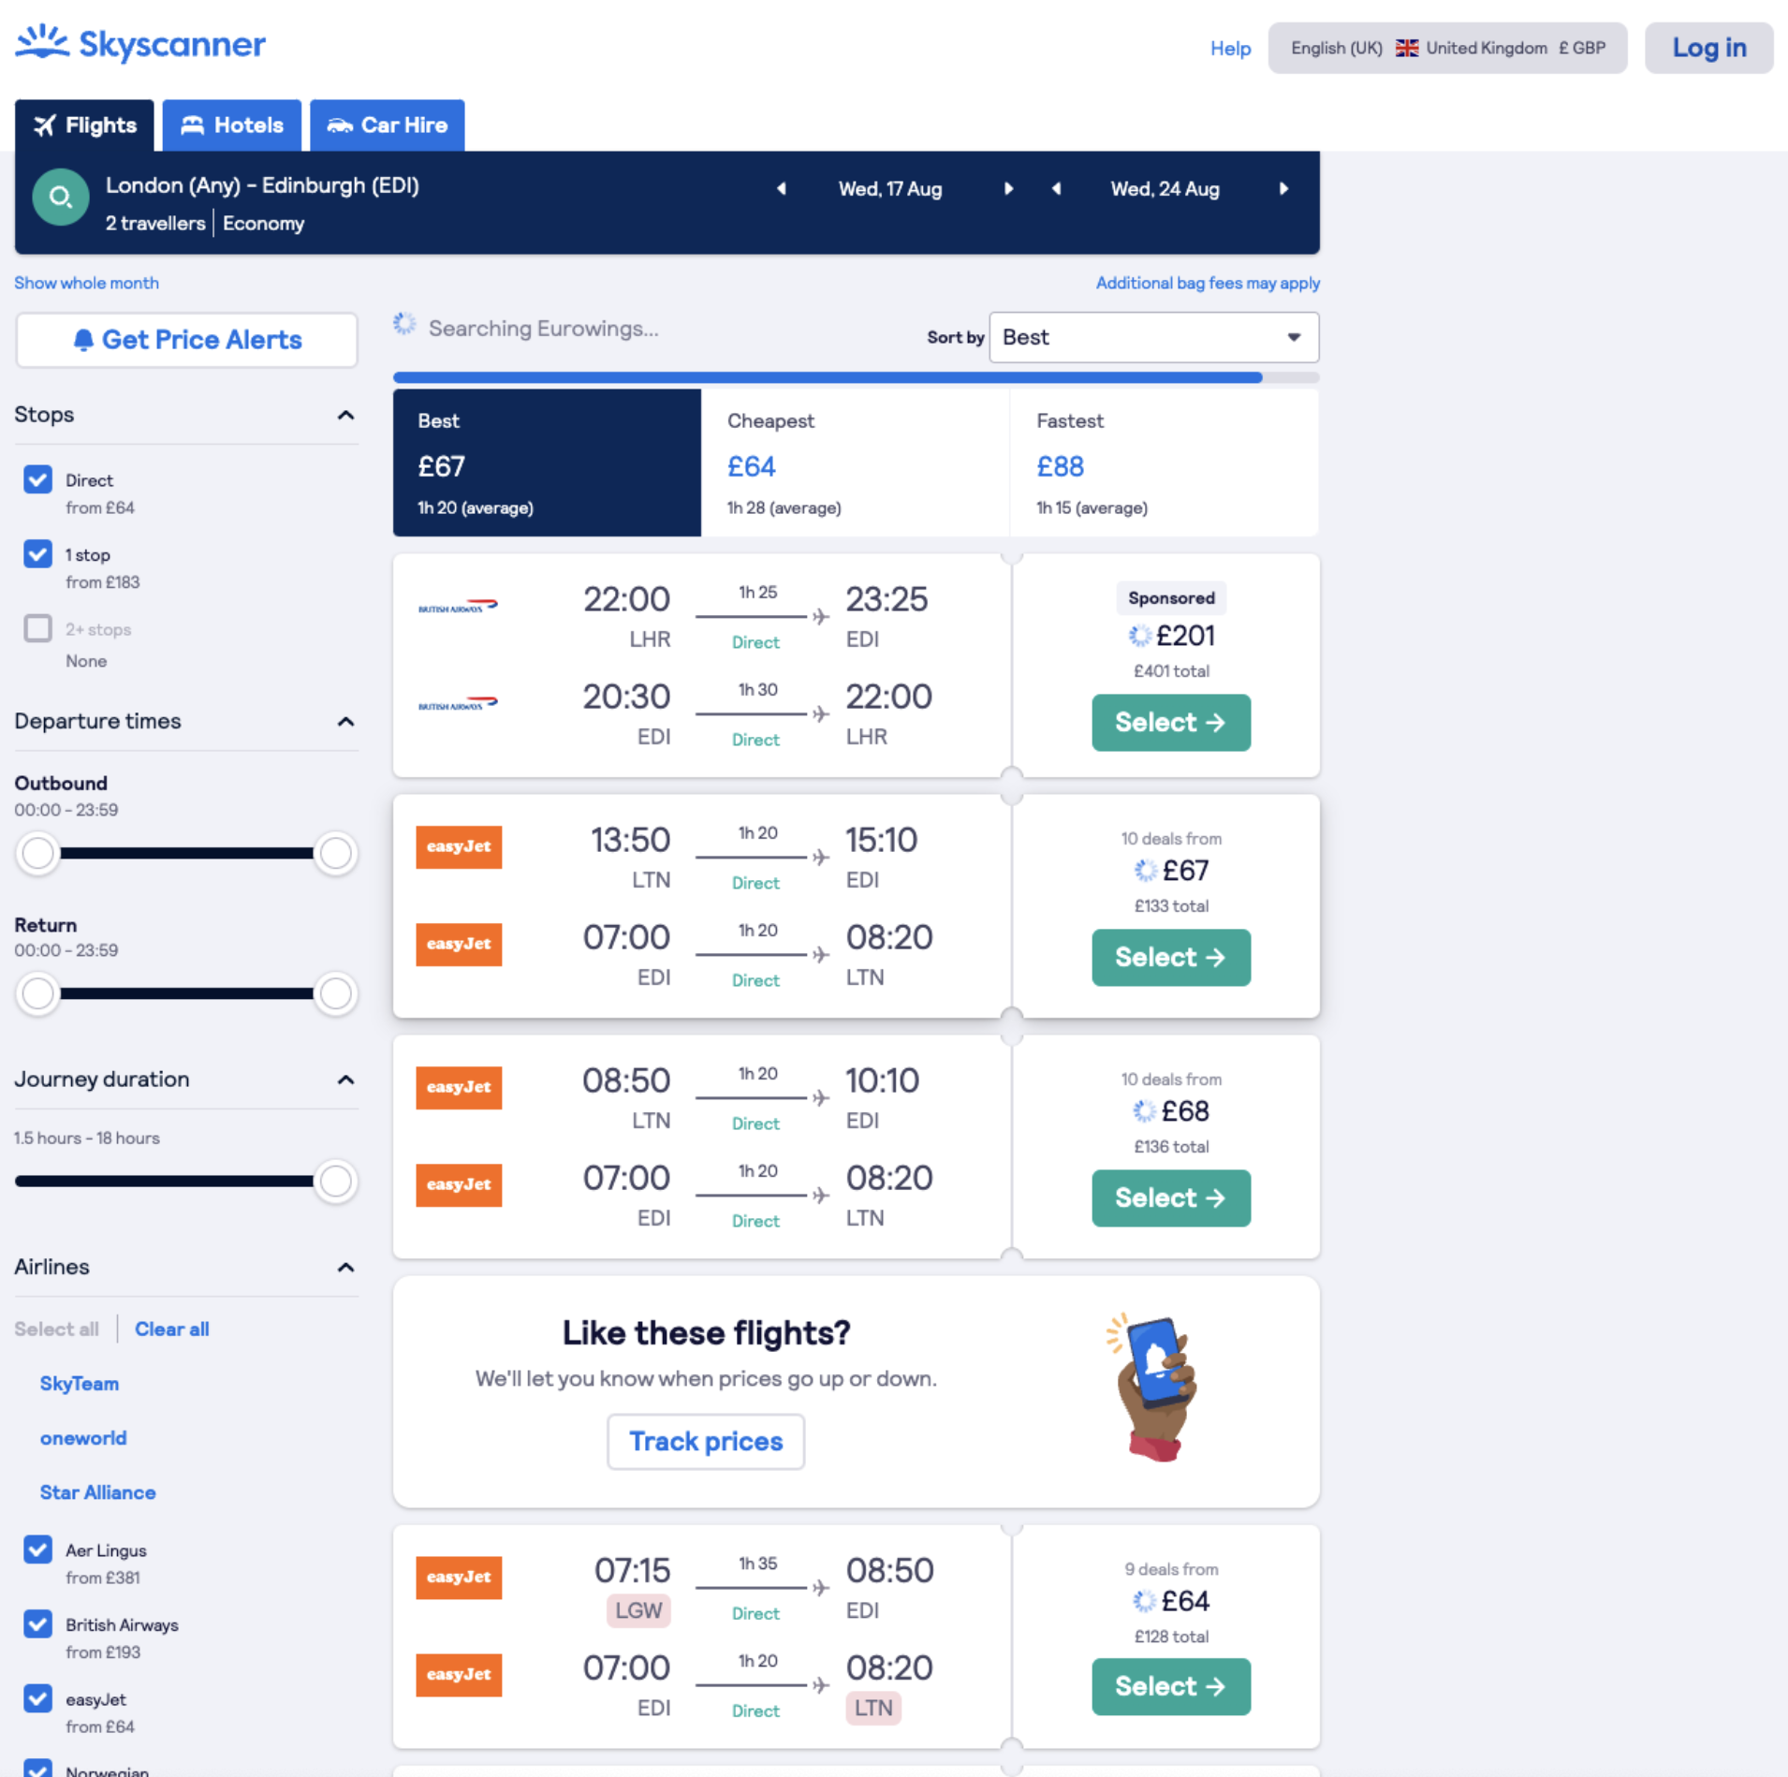

Why do we need APIs?
Communication between systems

Slide 4

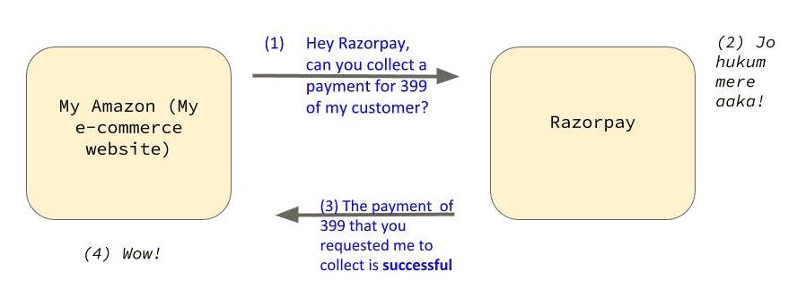

How does Amazon interact with a payments gateway for collecting payments ?

Slide 5
Did you just notice?
Can you see that how beautifully these two systems are talking with one another?
But the question is how are they talking to one another? They are talking to one another through a piece of code.
This piece of code through which two systems (applications) talk to one another is called as API. Exciting, isn't it?

Slide 6
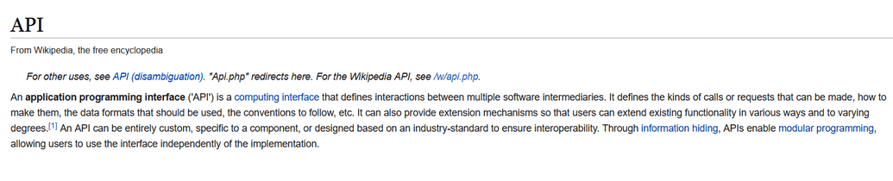
What is APIs?
Officially! API stands for Application Programming Interface. (Reading the definition of API on Wikipedia can give a nightmare.)
But, we have learnt a very simple definition (in the Amazon - Razorpay) example.
APIs are a piece of code through which two systems (applications) talk to one another.

Slide 7
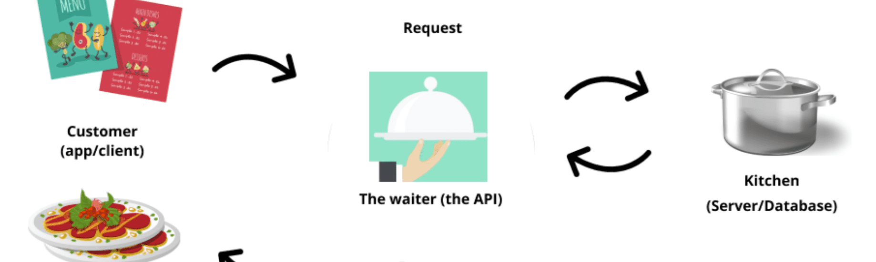
Dominos analogy

Slide 8
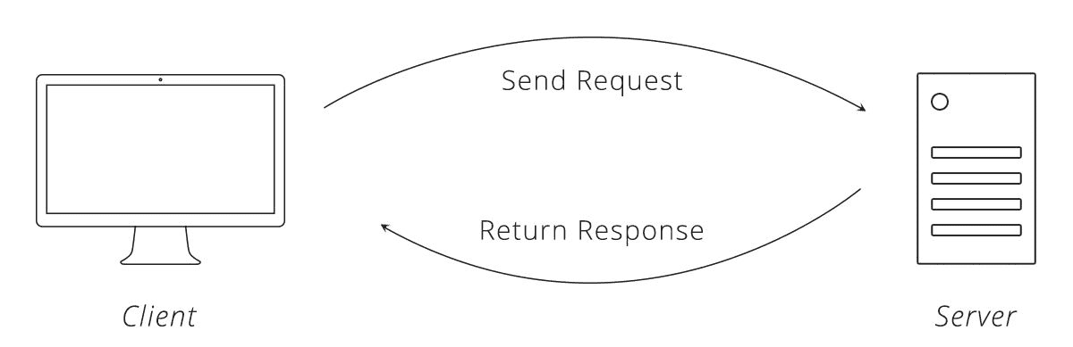
Request + response cycle
The piece of data that you send to the server is called as Request.
Here by you, I mean, your web browser. Btw! You in technical terms is called as client.
The piece of data that you get back from the server is called as Response.

Slide 9
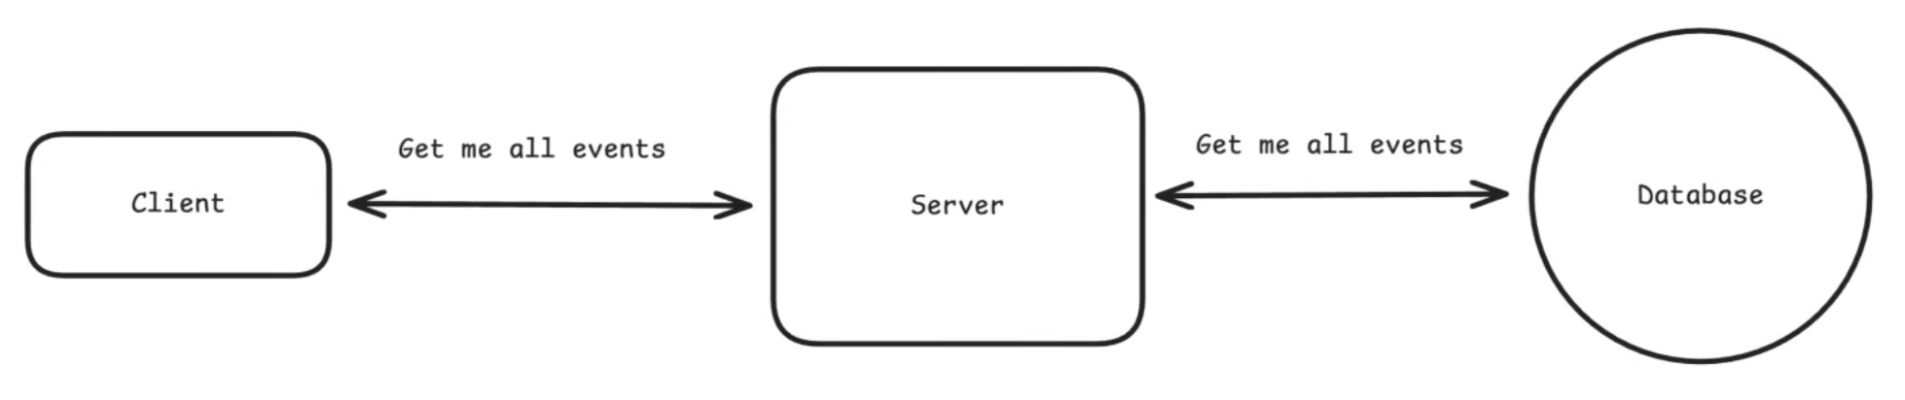
APIs are not just between client and server.
THEY HELP to communicate between two software components.

Slide 10
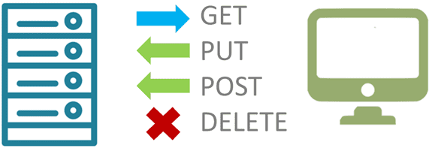
Types of Request
The four common types of request are ➖ GET, PUT, POST, DELETE
GET - You make a GET request to get some piece of data from the server. (RETRIEVE DATA)
POST - You make a POST request to add a new piece of data to the server. (CREATE DATA)
PUT - You make a PUT request to edit the existing piece of data on the server (UPDATE DATA)
DELETE - You make a delete request to delete a piece of data on the server (REMOVE DATA)

Slide 11


What language does client and server communicate?

Slide 12
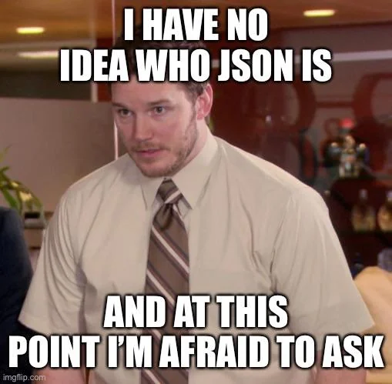
What is JSON?
You might be wondering, from where did JSON come here? We were studying API. Right?
Wait! Let me explain. As I have said earlier, you make a request to the server to get a piece of data. Right?
Remember, the data always comes in a specific format. Think of a spreadsheet file. It always comes in .csv or .xls format. Similarly, API responses can come in various formats like XML, JSON etc.

Slide 13
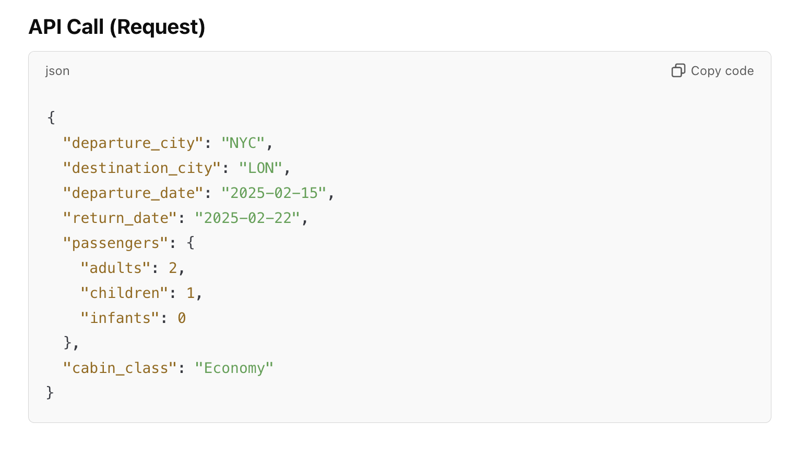

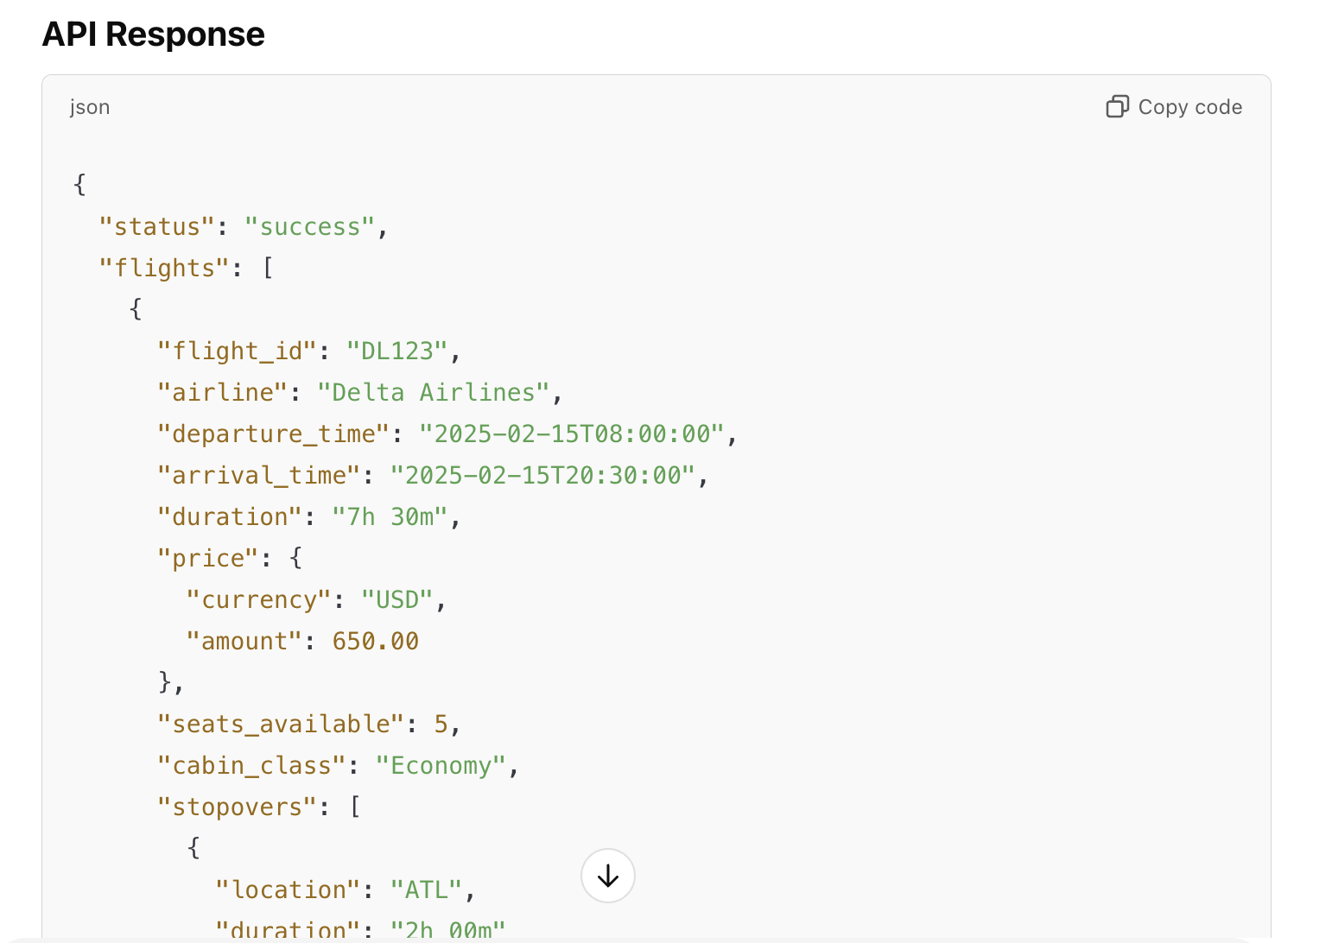
Skyscanner & OTA-flight operator

Slide 14
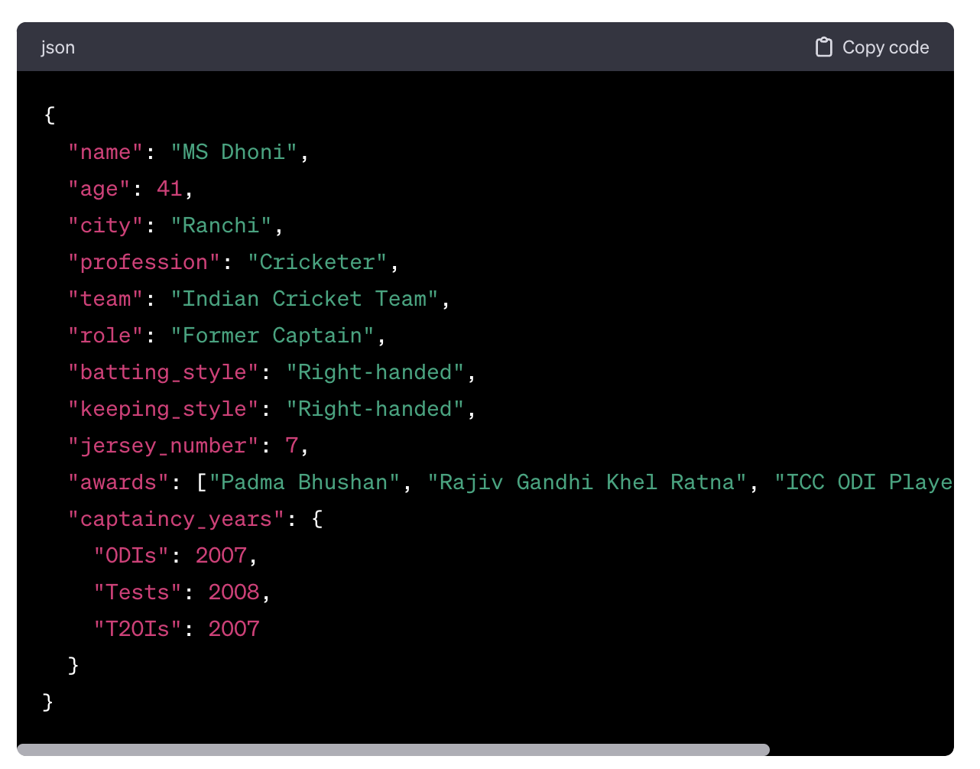
What is JSON?
Normally, we get the data in JSON format these days.
Suppose, you have requested to get data of MS Dhoni (name, age, and city) from the Cricbuzz server. The server will give you the data in a specific format as given below. This data format is called as JSON.

Slide 15
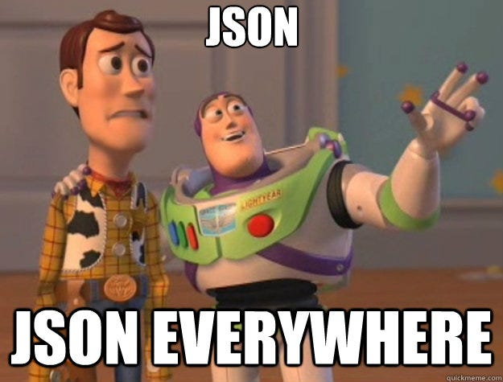
What is JSON?
JSON stands for JavaScript Object Notation.
JSON (JavaScript Object Notation) is a lightweight data-interchange format.
It is easy for humans to read and write.
It is also easy for machines to parse.
It is a collection of key/value pairs.

Slide 16
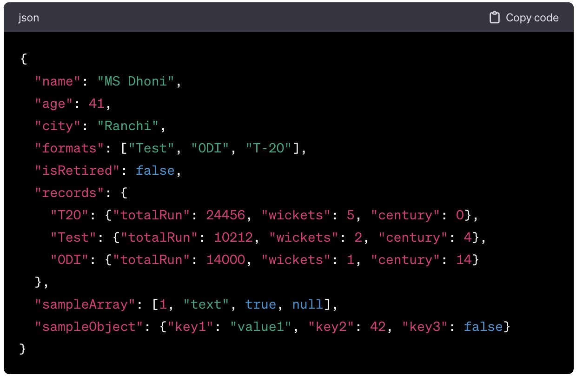
JSON
JSON describes the data in key-value pairs. For e.g. - name is key & "MS Dhoni" is value.
Keys & values are separated by a colon ( : )
If the value is a string, it is mentioned in double-quotes.
A JSON value can be an object, array, number, string, true, false, or null, and JSON structure can be nested up to any level.

Slide 17
API vs JSON
Feature API JSON
What it is A communication interface A data format
Purpose Defines how systems talk Defines how data looks
Example GET /users { "name": "Saksham", "age": 26}

Slide 18
How can APIs be designed?
There are different architecture pattern (set of rules) followed while designing an API.
Top 3 API architecture patterns are -
  REST → 90%
  GraphQL (https://graphql.org/learn/ ) → 9%
  RPC → 1%

Slide 19
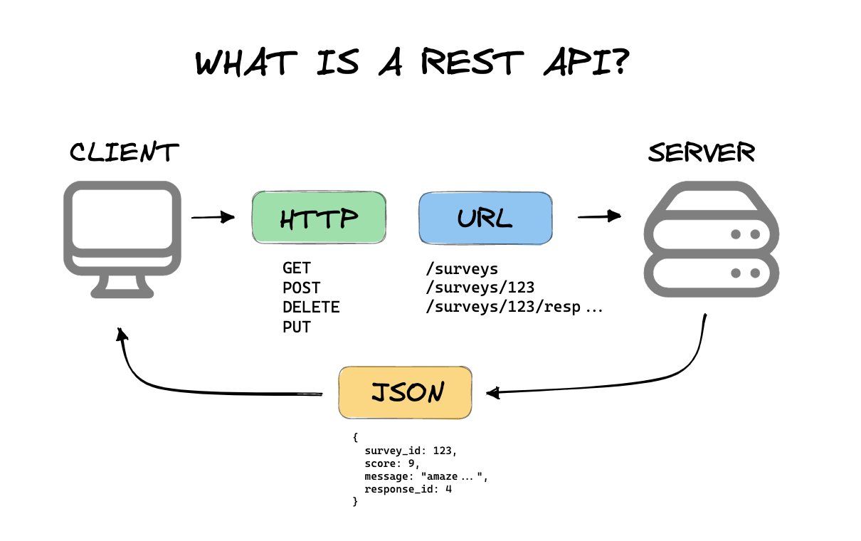
REST APIs
REST is a set of rules that developers follow when they create their API.
When an API follows the rule of Representational State Transfer; they are called REST API.

Slide 20
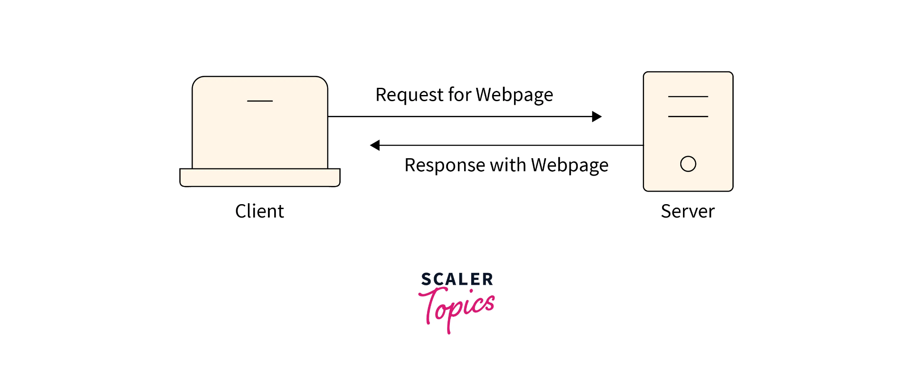
Key attributes of Rest API
Client-Server Architecture
The client (e.g., a web browser or mobile app) and the server (e.g., backend system) are independent of each other.
The server provides resources, and the client consumes them.
Example: A weather app (client) fetches data from a weather API (server).

Slide 21
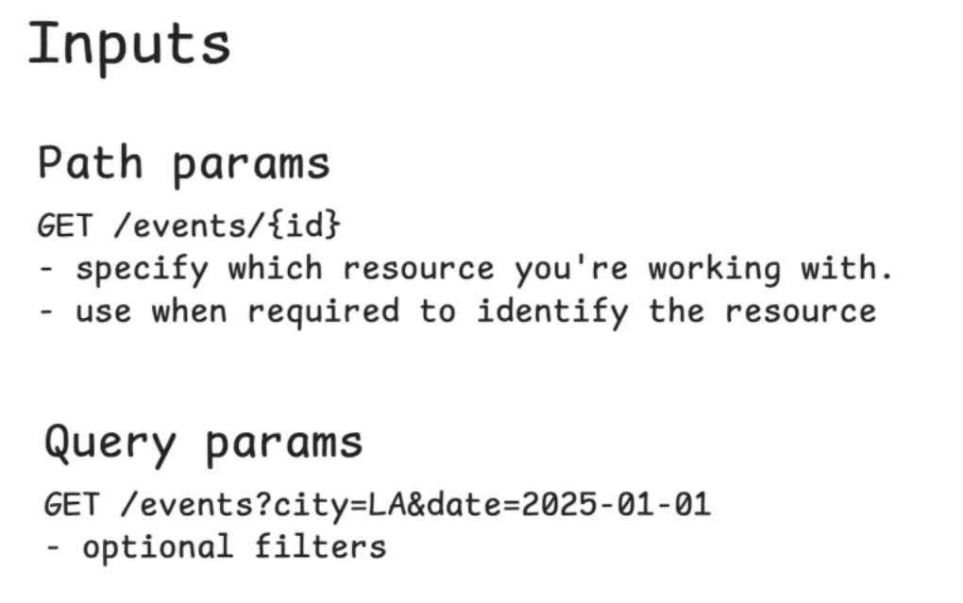
INPUT IN REQUEST in REST API

Slide 22
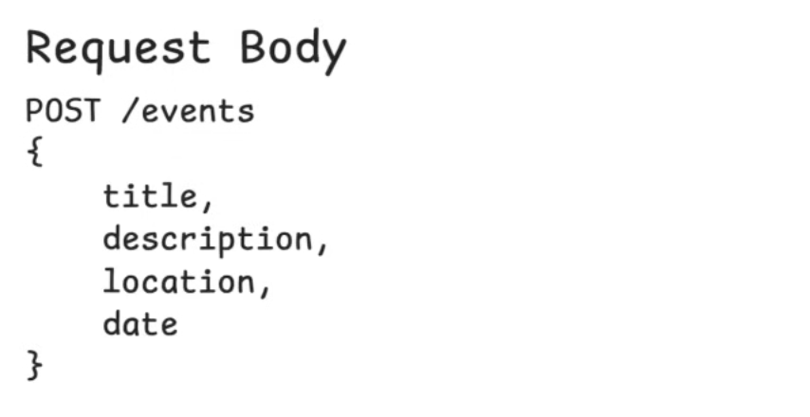

Slide 23
Quiz
You are designing an API for the product search feature. Which API endpoint and query parameter combination would be most suitable for retrieving a list of mobile phones priced between $200 and $500?
Options:
Endpoint: /api/products/search
Query Parameters: category=mobiles&min_price=200&max_price=500
Endpoint: /api/mobiles
Query Parameters: price_from=200&price_to=500
Endpoint: /api/products/filter
Query Parameters: category=mobiles&priceRange=200-500
Endpoint: /api/search
Query Parameters: type=mobile&price=200-500
Notes:
A is right.
Clear and RESTful: /api/products/search clearly indicates you’re searching products.
Flexible design: Supports additional filters (like brand, rating, etc.) in the future.
Standard naming convention: min_price and max_price are self-explanatory and common in APIs.
Generic but specific enough: Category and price filters are clearly separated.

Slide 24
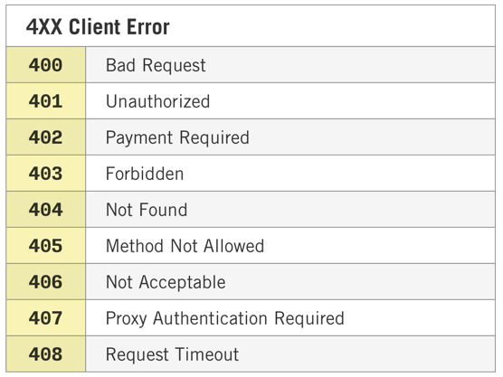
Key attributes of Rest API
HTTP status code
REST APIs use standard HTTP status codes to indicate the outcome of a request:
200 OK: The request was successful.
201 Created: A new resource was successfully created.
404 Not Found: The requested resource does not exist.
500 Internal Server Error: Something went wrong on the server.
4xx : CLIENT ERROR
5xx: SERVER ERROR

Slide 25
How to work with an API?
So far we have learnt what requests and responses are. We also learnt about endpoints, query parameters and body data.
To get started with any API, you need to do the following ➖
Read the API documentation carefully.
Find which endpoints which matches your business need.
Check whether there is any authentication/authorisation required to access the API.
Test the API through Postman or by curl request.
Implement via code

Slide 26
Exploring API documentation
Let's say you want to integrate Google signup API on your website
What would be the first step? The first step would be to read the APIs documentation.
API documentation always the starting point when it comes to working with APIs.
Remember! A good API should have detailed documentation explaining how to work with it.
It should describe the basics - what the API does, what type of data you can get from it?
It should explain the requirements for using the API. Is it free or paid? Does it require you to register and obtain a key?
It should also provide examples of how to make requests and the responses returned.
And most importantly, for actually working with the API, it should provide you with endpoints and parameters.
Note - API Documentation is also called API contract.
Checkout sample API documentation - https://drive.google.com/file/d/1F3IKpbYee2MClDhZ1-BdUGXnE_9UmgCz/view?usp=sharing

Slide 27
Sample API documentation
Here are a few examples of the best API documentation you can read and play around with.
Stripe - https://stripe.com/docs/api
Notion - https://developers.notion.com/
SendGrid - https://sendgrid.com/solutions/email-api/
Github - https://docs.github.com/en/rest

Slide 28
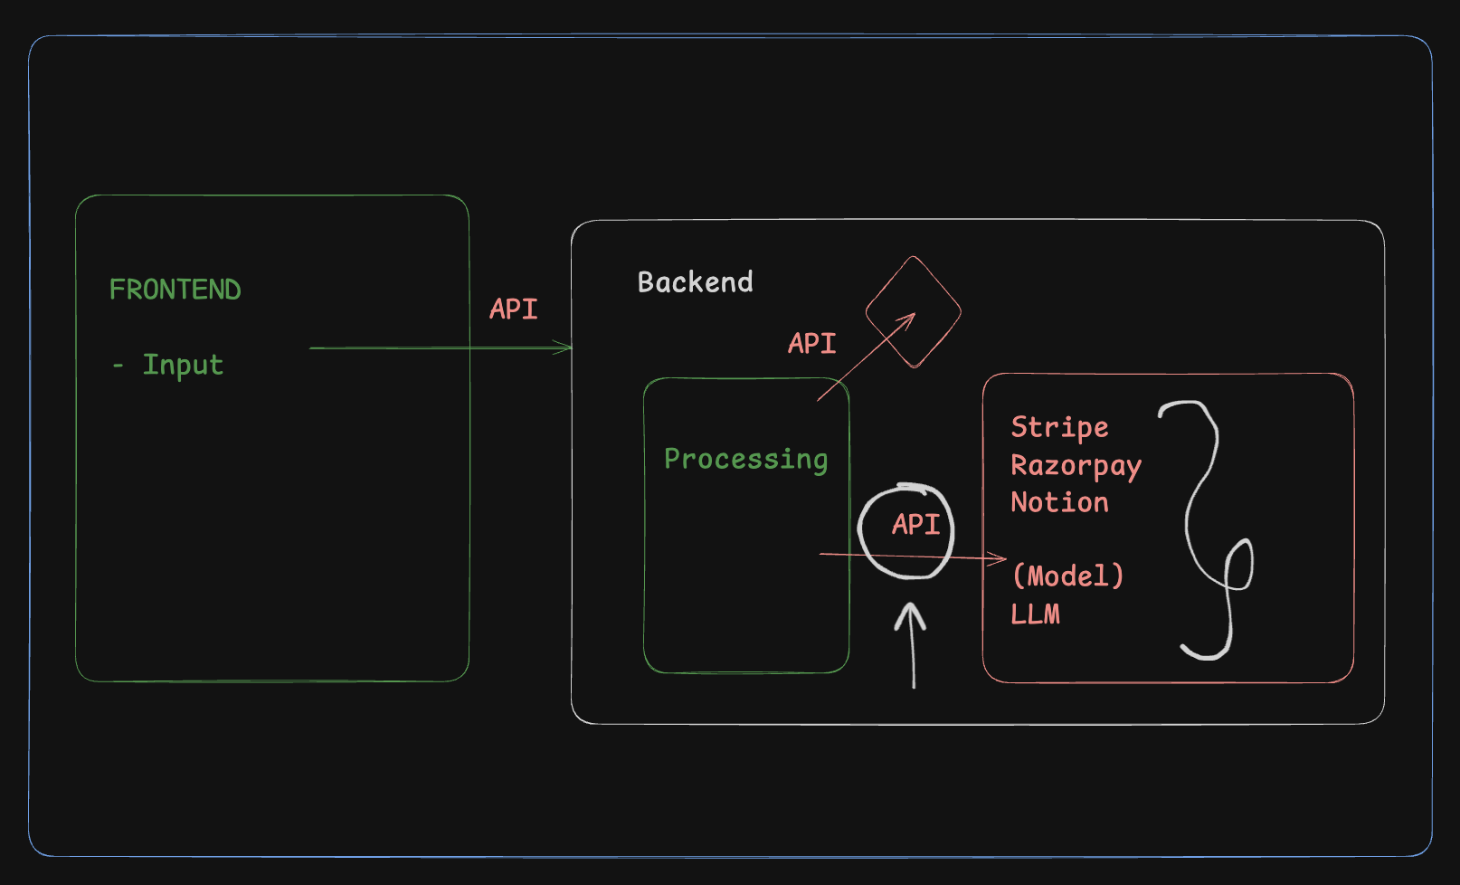

Slide 29
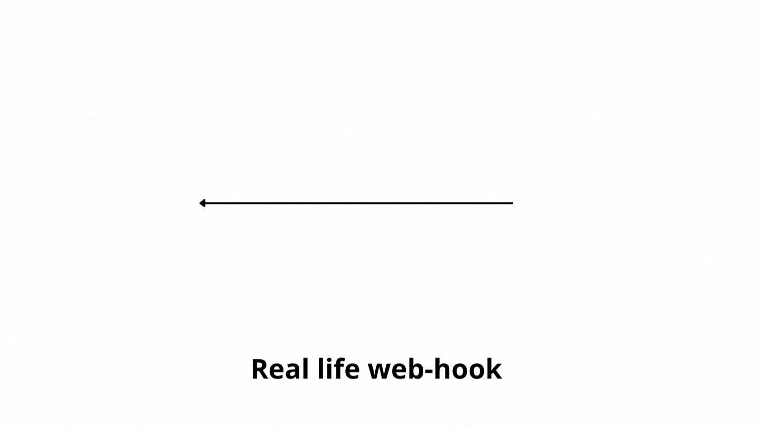
What are webhooks?
Webhooks are events that get triggered when an event is successful i.e. your girlfriend calling you when she reaches her home is analogous to webhooks.

Slide 30
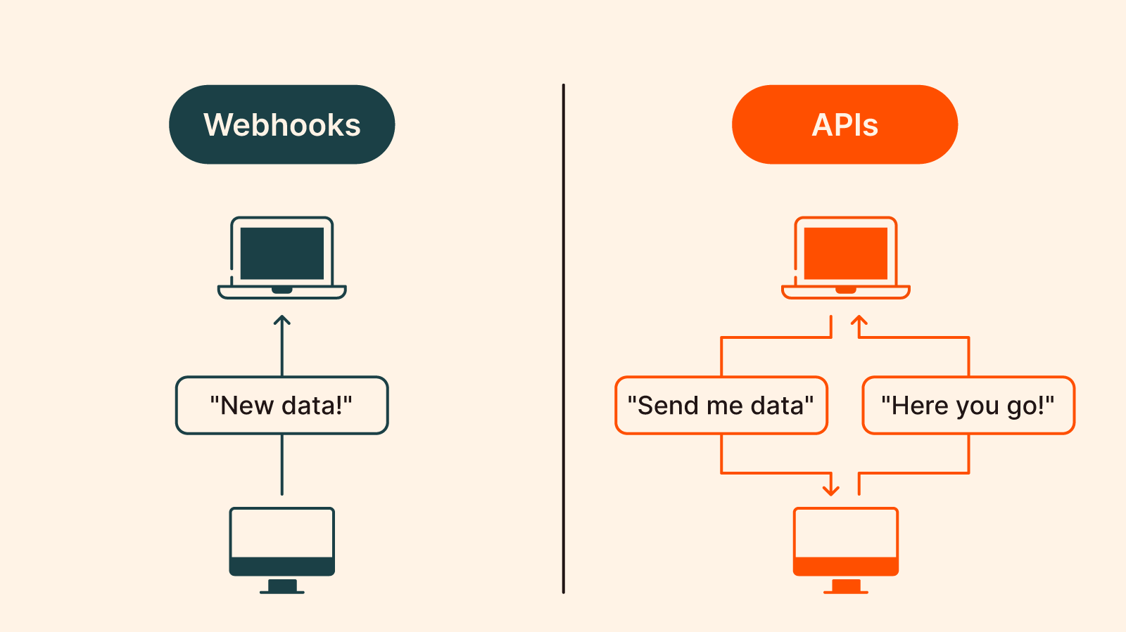
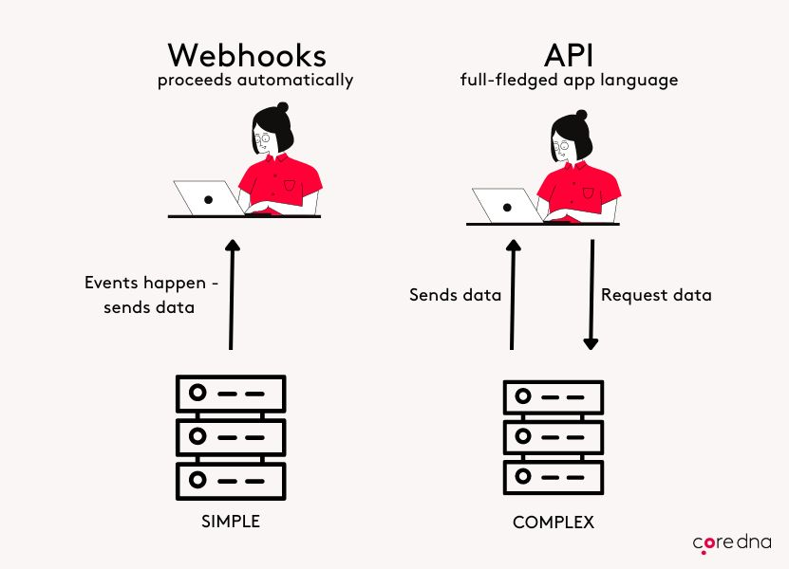
API vs webhooks

Slide 31
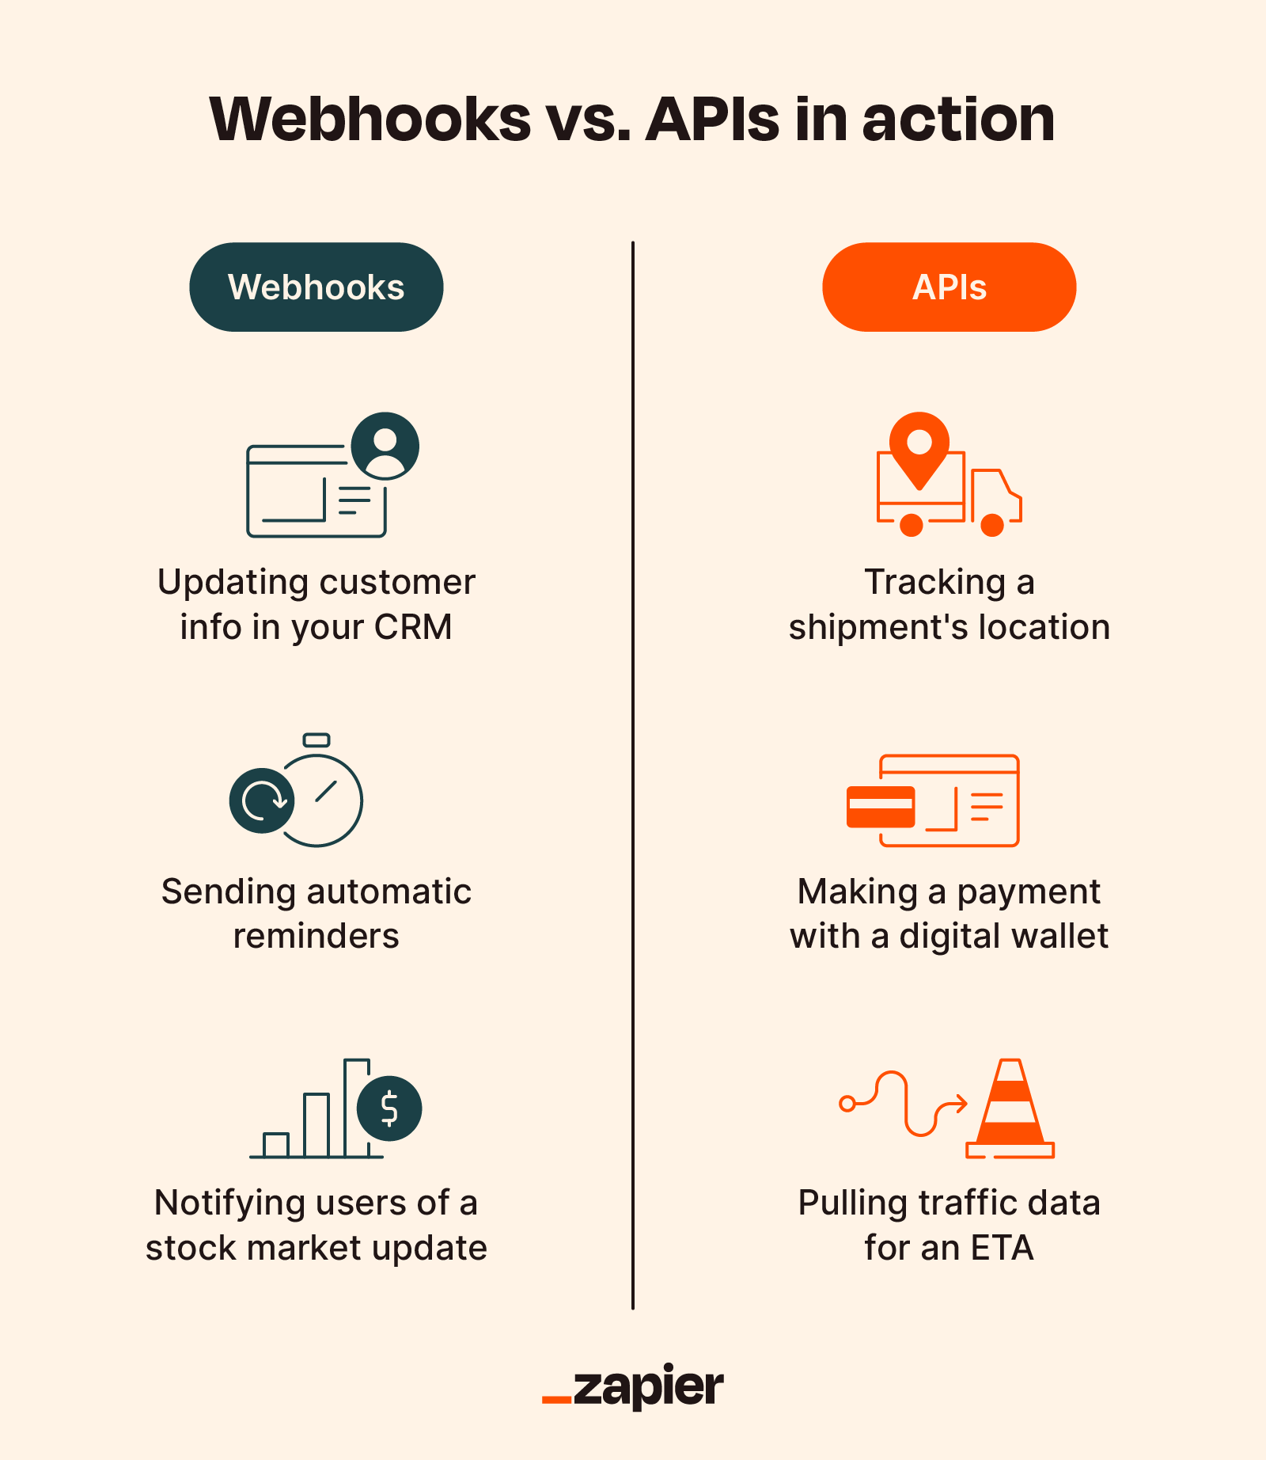
API vs webhooks

Slide 32
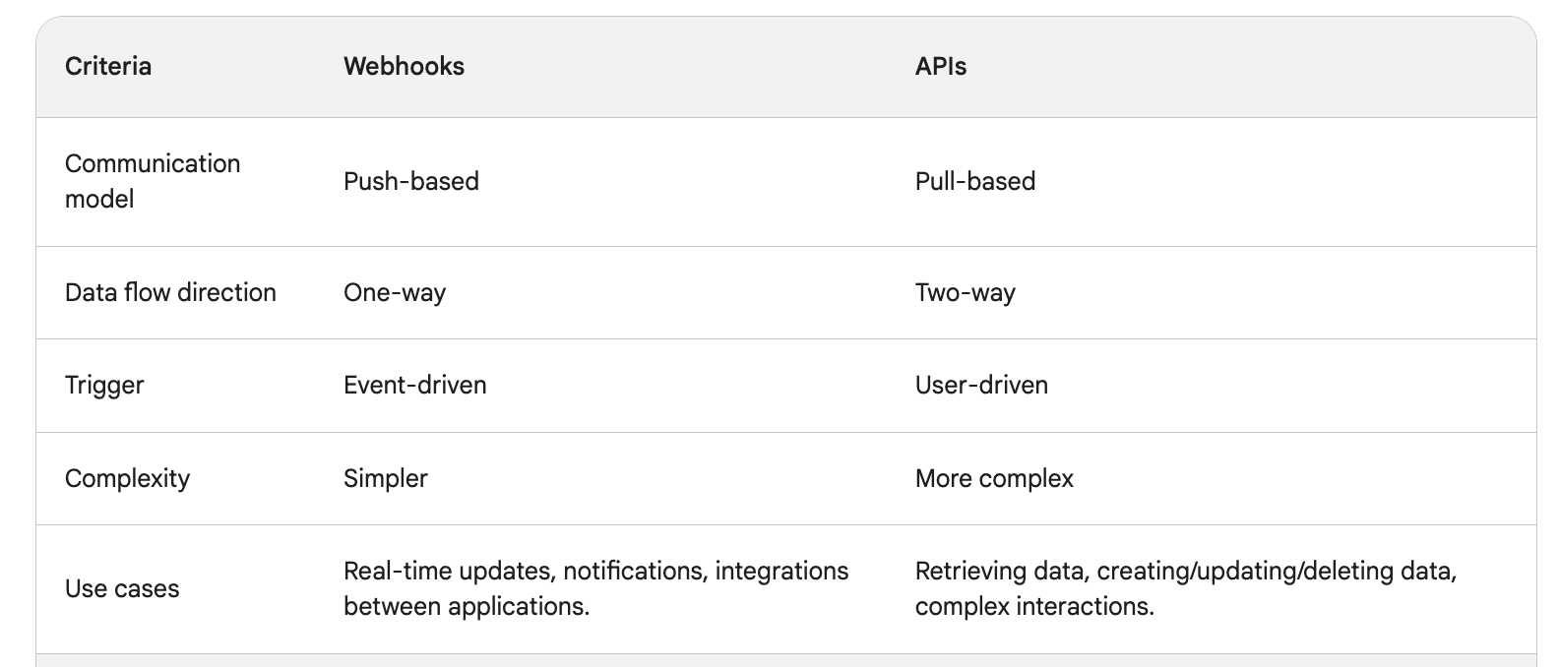
Webhooks vs API

Slide 33
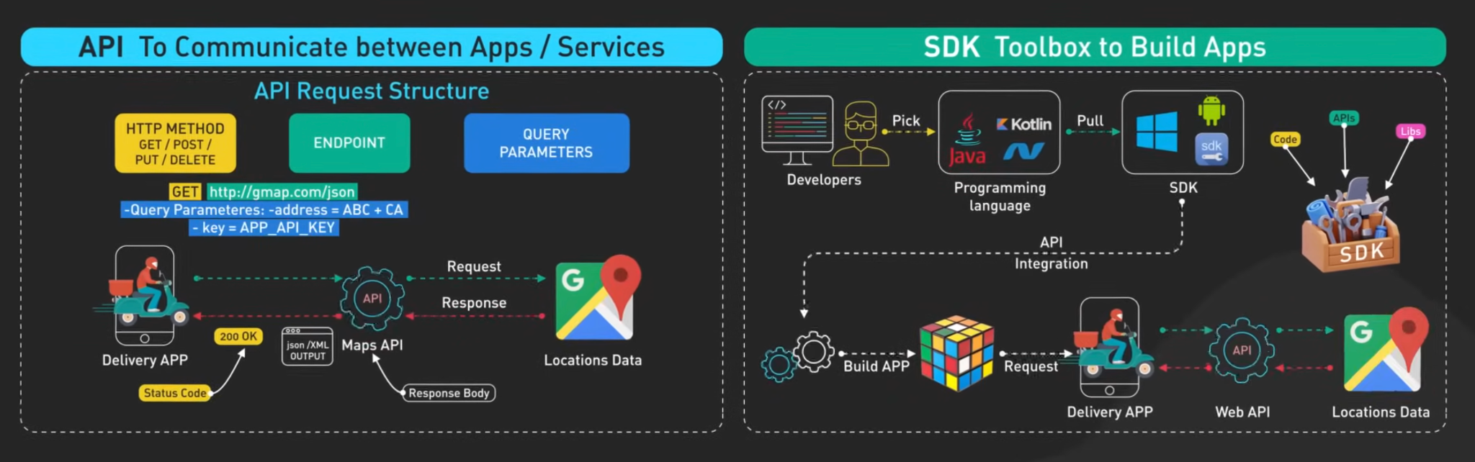
API and SDK

Slide 34
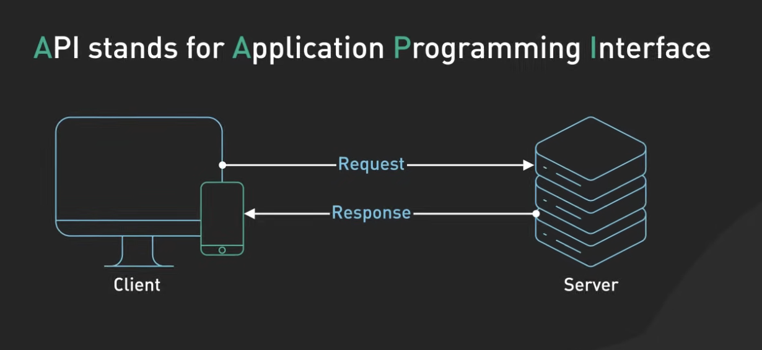
API help us to make raw connection with the server.

Slide 35
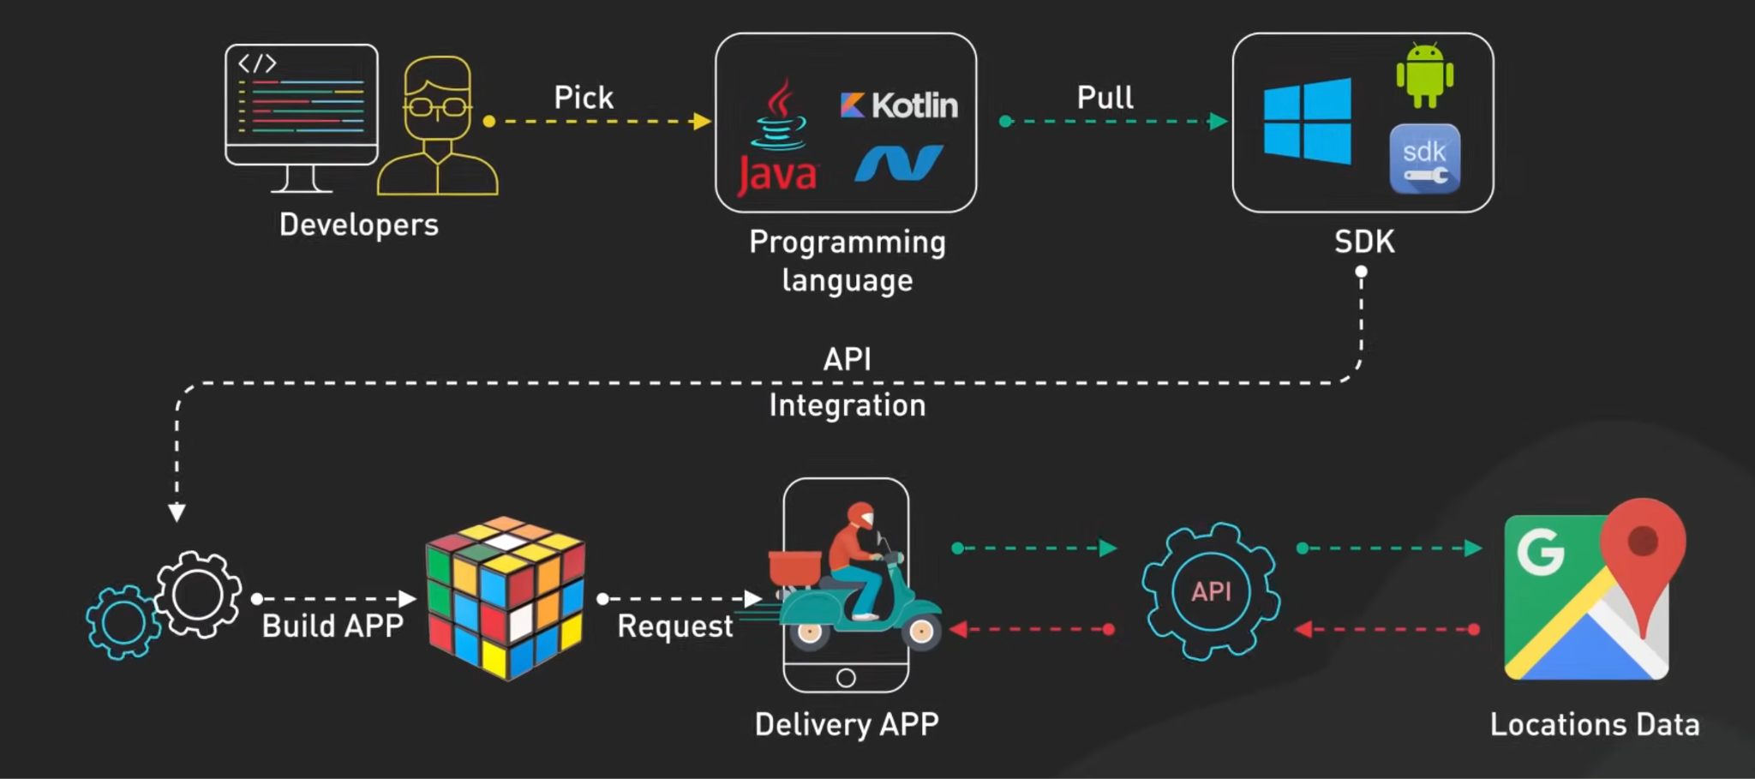
SDK are like prebuilt tools which makes all connections easy to use.

Slide 36
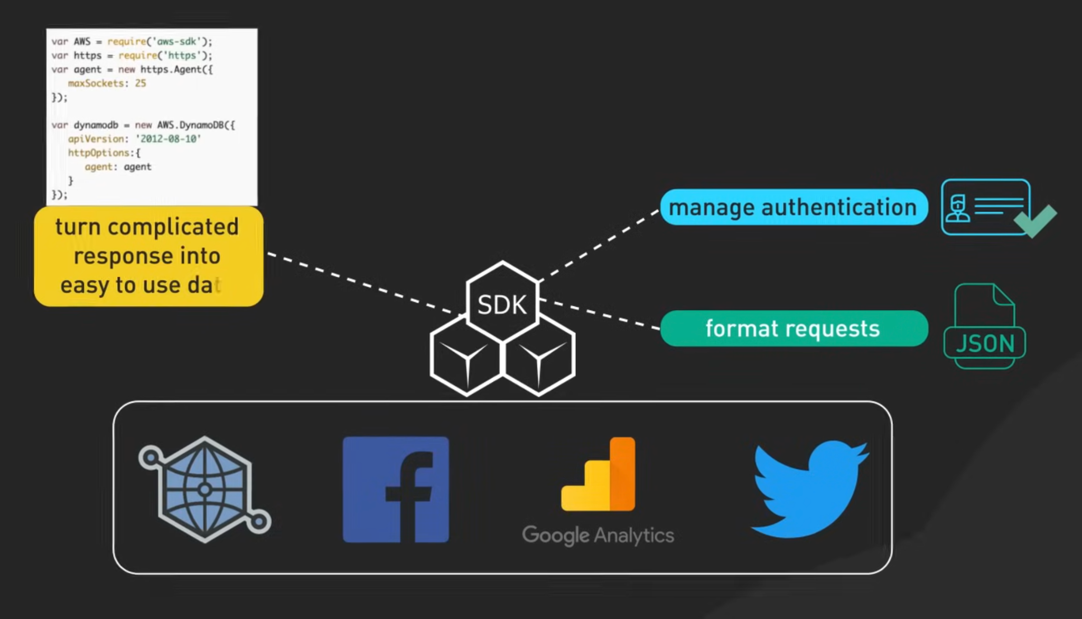

Slide 37
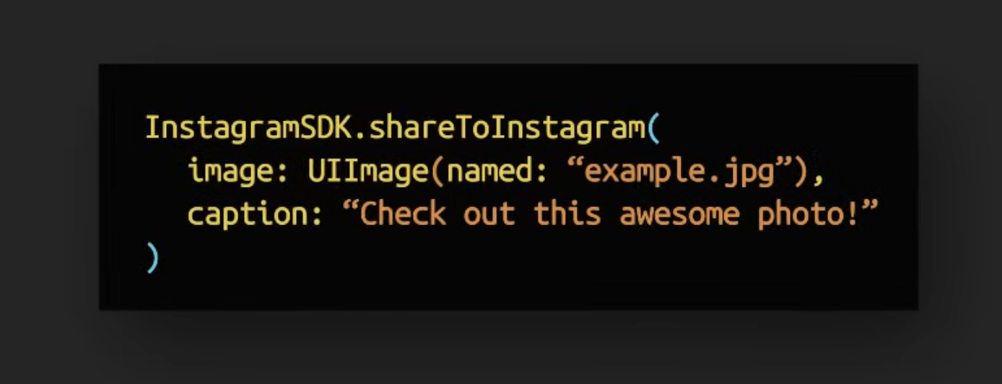
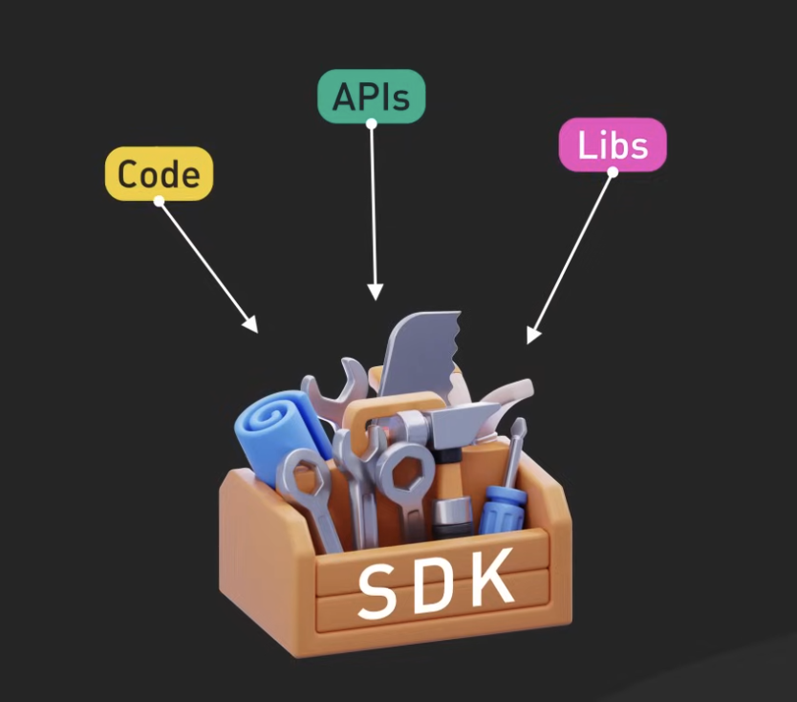

Slide 38
Basis | API (Application Programming Interface) | SDK (Software Development Kit)
Definition | A set of rules and protocols that allows different software applications to communicate with each other | A collection of tools, libraries, documentation, and APIs used to develop applications
Purpose | Enables interaction between software systems | Provides everything needed to build and develop applications for a specific platform
Components | Endpoints, request/response formats, authentication rules | APIs, libraries, debugging tools, compilers, documentation, code samples
Usage | Used to connect applications or services | Used to create applications or features
Dependency | Can be used independently | Often includes one or more APIs
Example | Google Maps API to fetch location data | Android SDK to build Android apps

Slide 39
Thank You
Saksham Arora - Intuit | LinkedIn
SAKSHAM

